Slide 1

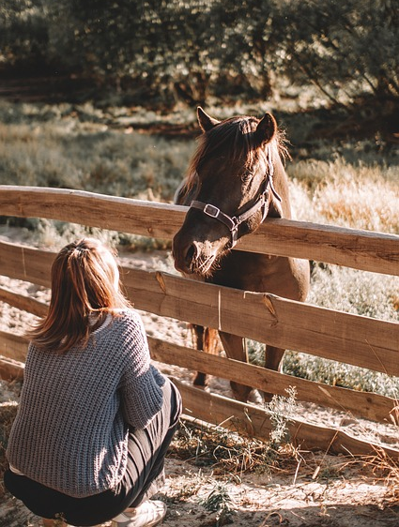
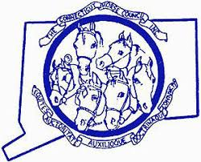
Why Horses Make Good Neighbors
Presented by
The Connecticut Horse Council
“Horsemen united in Leadership, Service, and Education

Slide 2
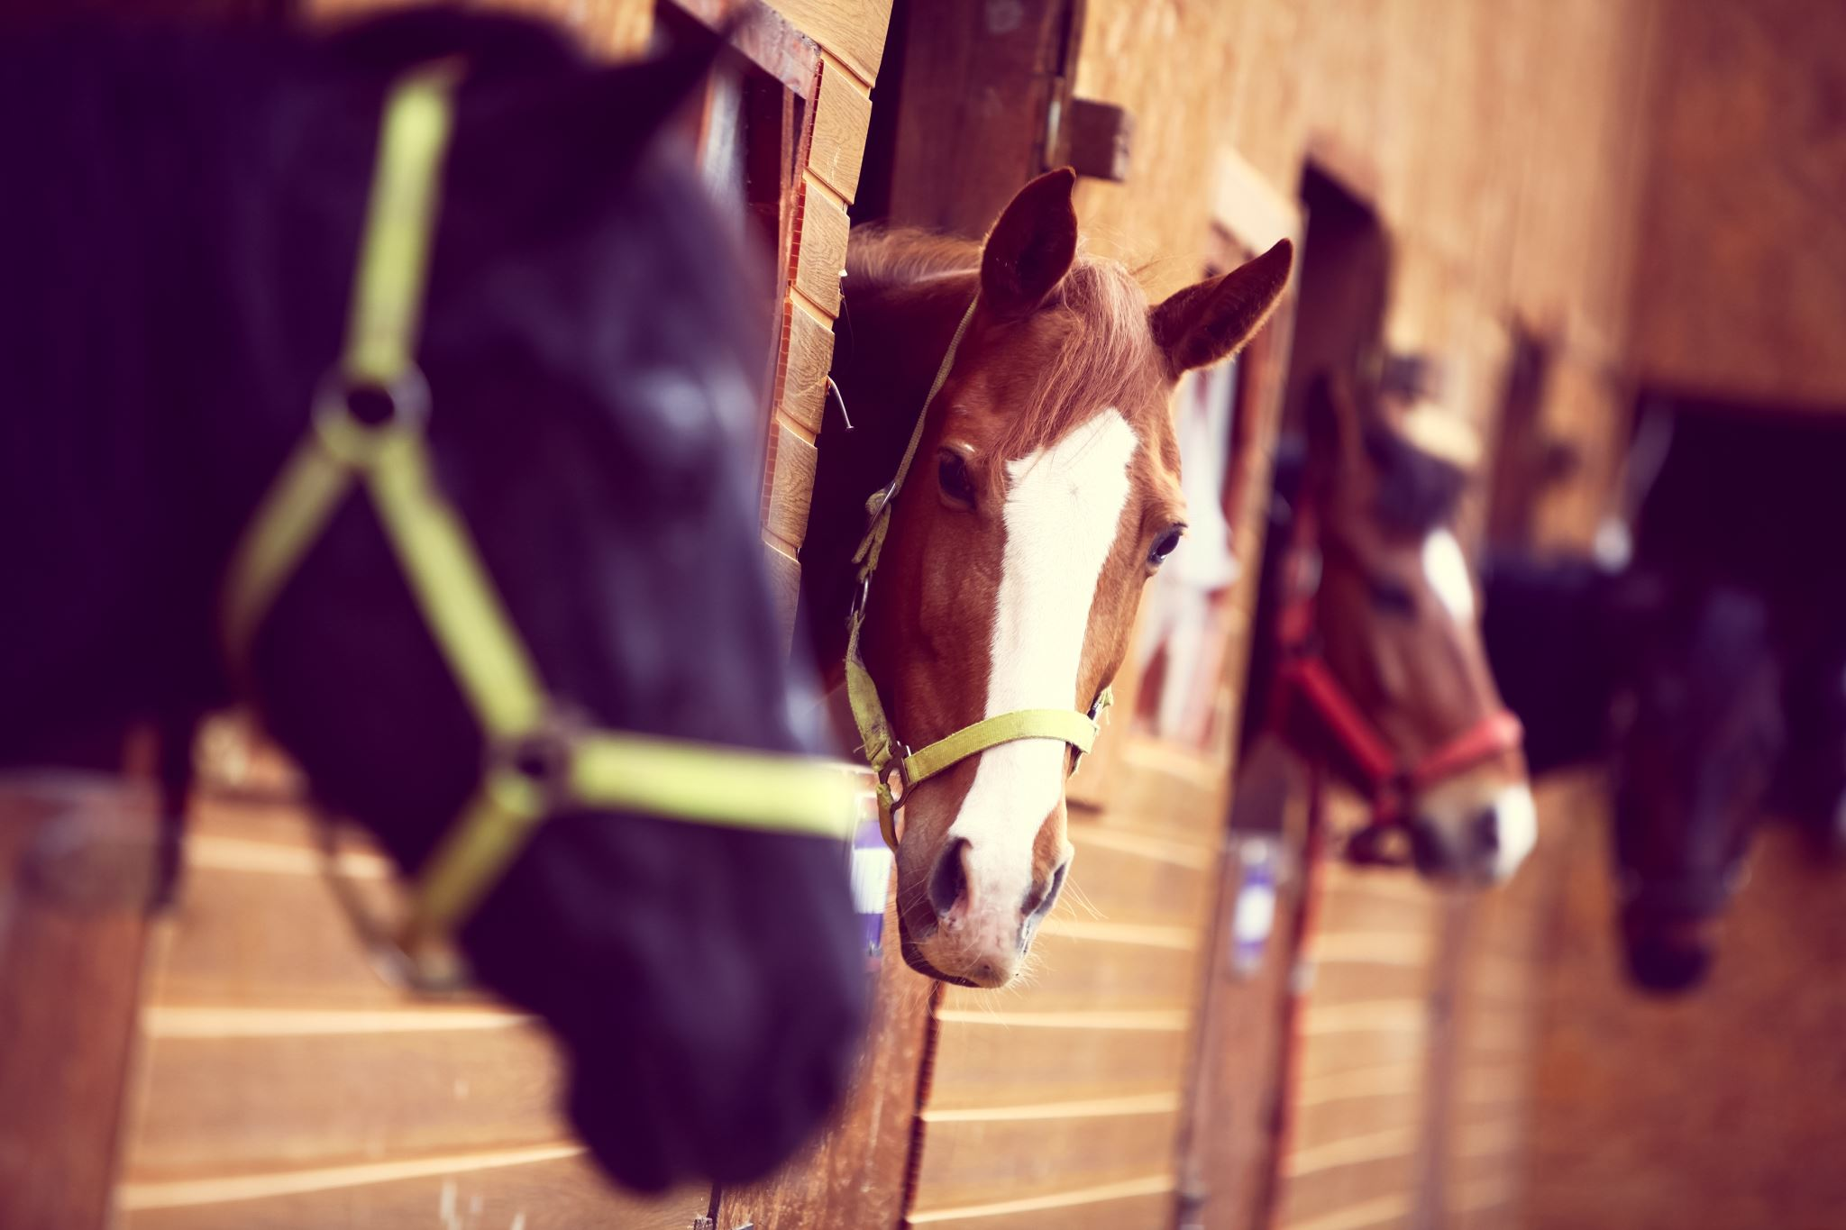
Why Are Horses Good Neighbors?
Good neighbors are sometimes hard to come by. Sure, there are lots of neighbors who tend to their own business and thankfully don’t interfere with yours. Some keep a tidy home and yard. But what about really GOOD neighbors – neighbors who contribute much more to your community than they receive in return?
If you are reading this, odds are you don’t own a horse. Maybe you don’t know that much about horses. Maybe you don’t necessarily view horses as assets to your community, and perhaps you even see downsides to having them around. If so, please take a moment to consider some of the positives of having horses in your community. There are many reasons, when you stop and think about it, why horses really do make good neighbors.

Slide 3
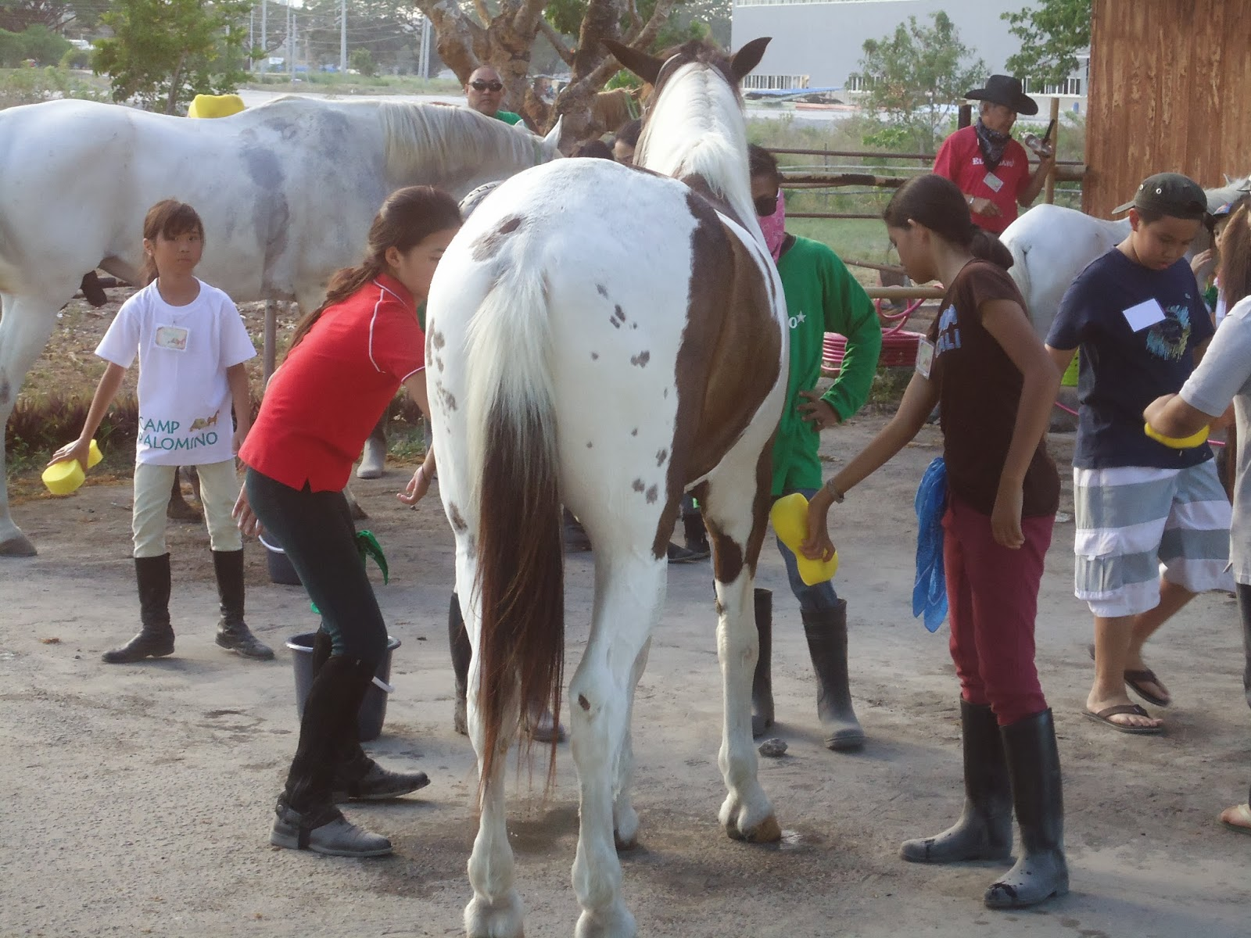
Horses Are Good Teachers.
When working with horses, children and adults learn a plethora of skills in many different areas, including:
Respect for animals.
Safety protocols.
Behavioral psychology.
Communication.
Health care.
Hygiene.
Nutrition and diet.
Composting.
Physical balance.
Leadership.
Soil & water quality.
Reproduction & genetics.
Land management.
Rigging & knot tying.
Grooming techniques.
Animal husbandry.
Equipment maintenance.
Compassion.
Negotiation skills.
Materials science.

Slide 4
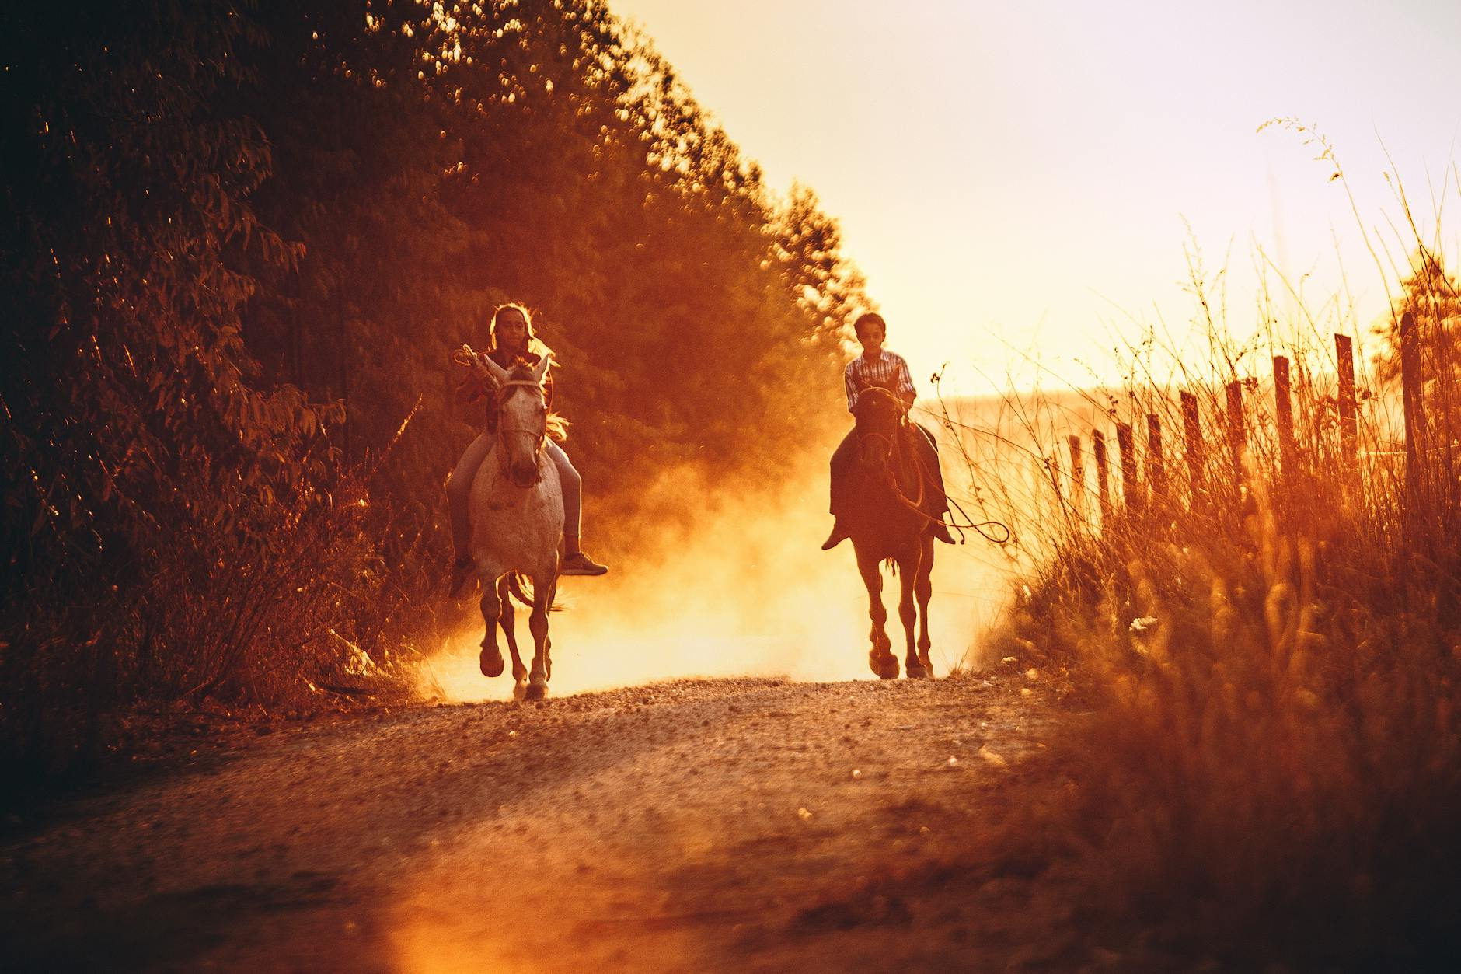
Horses Keep Us Healthy.
There’s no denying that working with horses requires physical effort and is a great way to exercise. Consider how the following activities provide exercise opportunities for those who handle and care for horses:
Riding
Catching / leading
Mucking stalls
Carrying feed / water
Carrying hay bales
Cranking trailer hitches
Fence work
Walking pastures
Grooming
Trimming / shoeing
Carrying saddles / tack
Climbing fences
Just think – every moment a person spends doing horse-related chores is a moment not spent idly in front of a screen.
And horses keep people mentally healthy as well as physically healthy. You’ve no doubt heard of Animal Assisted Therapy (AAT) – AAT helps individuals with emotional challenges improve their conditions through interactions with animals. Equine Facilitated Psychotherapy (EFP) is an emerging type of AAT.
The focus of EFP is not about recreation or riding. It involves setting up problem solving activities that involve horses and mostly takes place on the ground vs. in the saddle. Individuals with a variety of challenges; interaction with horses have been shown to reduce violent impulses in teens and alleviate PTSD suffered by many including veterans.

Slide 5
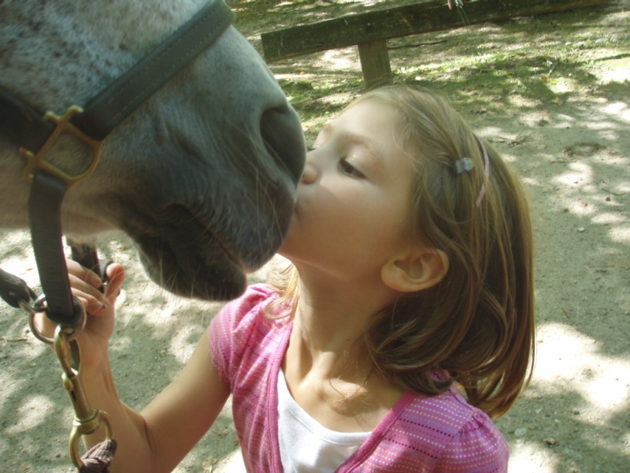
Equine-assisted therapies are being used to help people … The most striking examples of how we learn from horses occur in riding programs for mentally and emotionally challenged individuals. For instance, it is well-known amongst mental health professionals that horses help teach autistic children crucial skills that may not come naturally, including reading other’s emotions. Connecticut has several equine Therapy programs throughout our state.
A 2008 Children’s Hospital study in Longmont, CO confirms that horse therapy also teach autistic kids how to do things in sequence, supporting habits such as bedtime preparations.
In addition to being beneficial for children and adults with a wide range of physical, cognitive, and behavioral needs, equine-assisted therapies have also been used to successfully help in the treatment of people with depression, dementia, PTSD, anxiety, and substance abuse issues. For people with physical disabilities, riding horses has been shown to improve balance, muscle tone, coordination, and motor control.

Slide 6
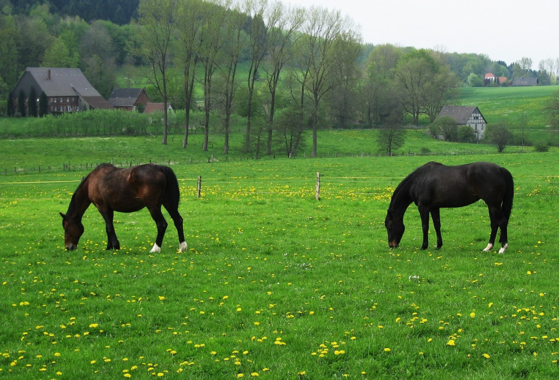
Horses Provide Beautiful, Affordable Views.
Continuing on that last point, most people find horses and horse pastures to be pleasant sights, especially on misty mornings and at sunsets. When you live next to horse pastures it’s sometimes easy to take for granted how much more inherently peaceful your daily views are than the views available to those residing next to commercial and modern housing developments.
Ask yourself this question – Would I rather live next to a cluster of houses and contend with concomitant traffic, or live next to undeveloped farmland with horses?
The thing about that is, so long as the land that surrounds you is being used for horses it will retain its rural character. However, if you evict the horses and allow that land to be developed, there’ll be no going back – that rural landscape will be gone forever, replaced by buildings and concrete and traffic – all of which will cost you, the taxpayer, much more money for community services than will the undeveloped farmland
So, consider the horses around you to be the placeholders and buffers from unsightly – and costly – development.

Slide 7
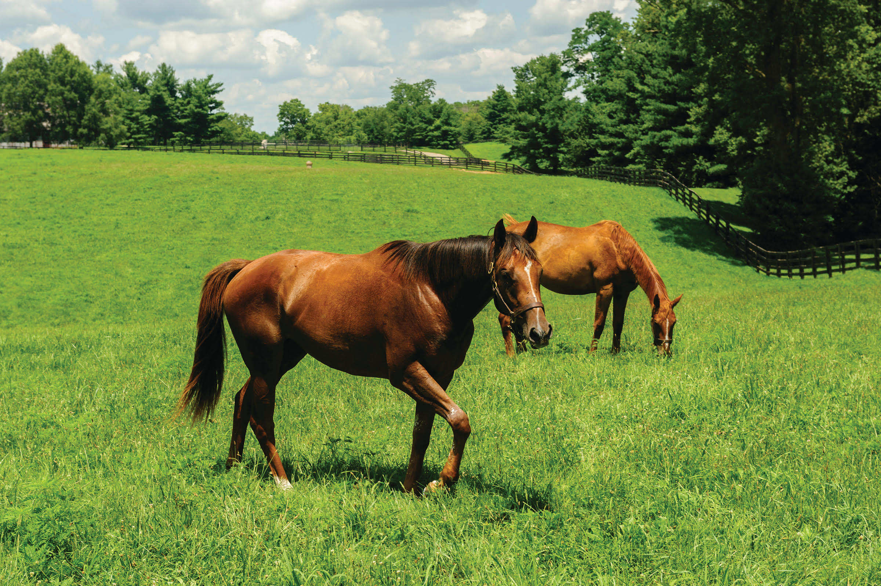
Horses Keep Open Spaces Open.
While we’re on the subject of beautiful farmland, did you know that land is being lost to development at the astonishing rate of 250 acres per hour? That’s 4.2 acres per minute. That means an eventually end to beautiful open spaces, replaced by concrete, buildings, air pollution, traffic, and power lines.
Open land is needed to produce food, protect wildlife, and filter impurities from the air – yet we are allowing our land to be lost an accelerated rate for the sake of development.
Horse farms preserve open spaces. Around the country, and in Connecticut, horse farms are keeping spaces open while other rural operations, like dairy farms, are rapidly disappearing.

Slide 8
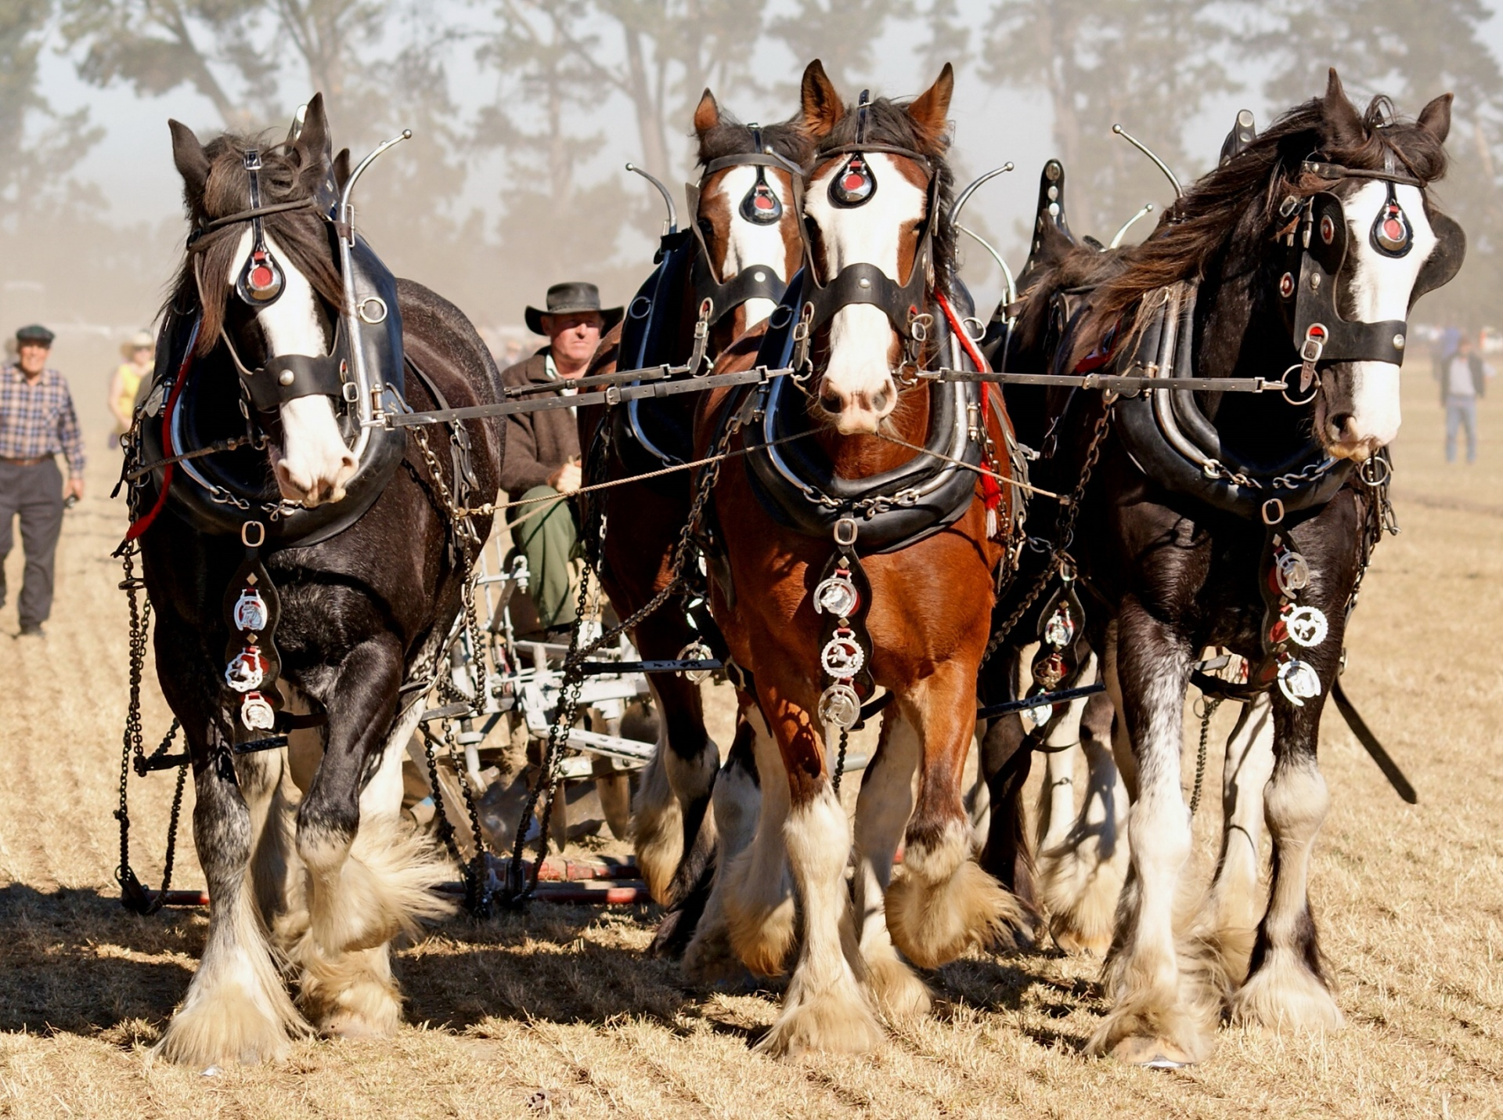
Horses Preserve our Heritage … Connecticut has a rich in history of how horses have been instrumental then and now.
When you ask a horseman or horsewoman why they’re so drawn to horses, they’re apt to shrug and respond with “it’s in my DNA” . Such a profound statement is perhaps a little easier to understand when you consider that people have pursued relationships with horses since before 2500 BC.
Historically we have relied on horses to help us feed ourselves and our families, travel distances, pull heavy loads, fight in wars, police our communities, fight fires, deliver mail, practice medicine, minister to the sick, engage in agriculture, managing livestock, transport goods, and free ourselves from British tyranny.
Horses are still an important form of transportation. As development consumes acre after acre of open space, people are turning at unprecedented rates to forests and parks to recreate and explore. Horses allow people to access natural areas they might not be able to reach on foot. This is especially important for trail lovers with disabilities.
And Horses Bring Families Together.
In rural America, horses remain an important family tradition and are often at the center of family gatherings. US Pony Clubs, 4-H,
and other youth-oriented organizations bring families together through equestrian and teambuilding activities.
The same goes for junior horse shows and other competitions like barrel racing and eventing. These venues provide unique opportunities for families to team up and learn from their horses and each other. And, across the country, families ride trails and camp together with their horses. In families with horses, kids often take part in daily chores and learn how to take care of others. This kind of responsibility contributes to valuable life skills in the long run.

Slide 9
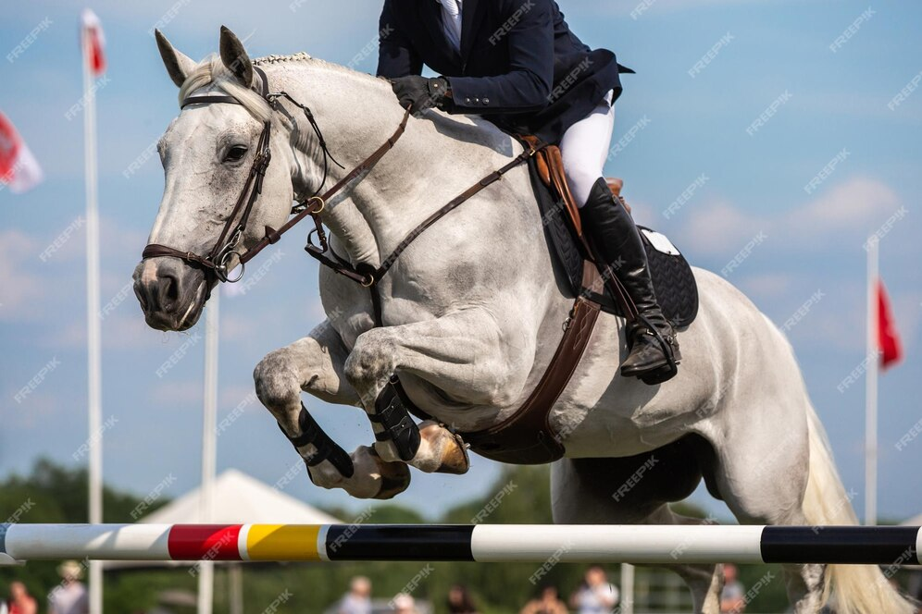
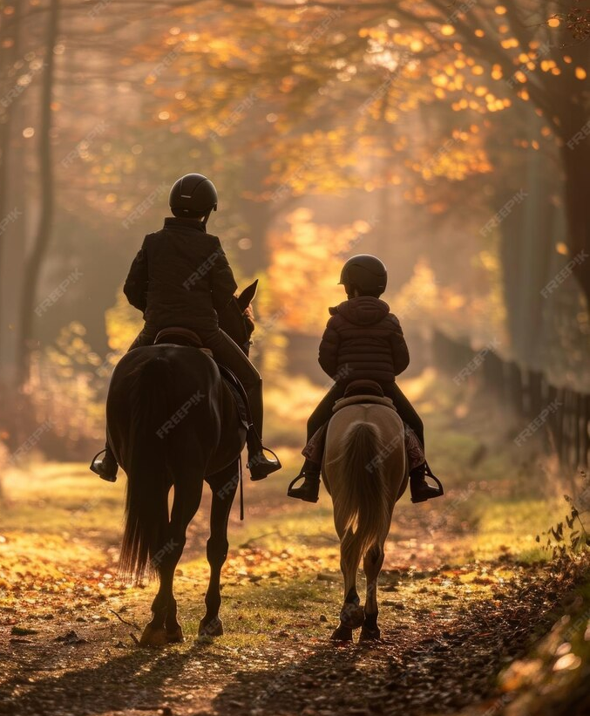
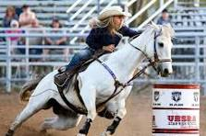
Horses Preserve our Heritage … And Horses Bring Families Together
.

Slide 10
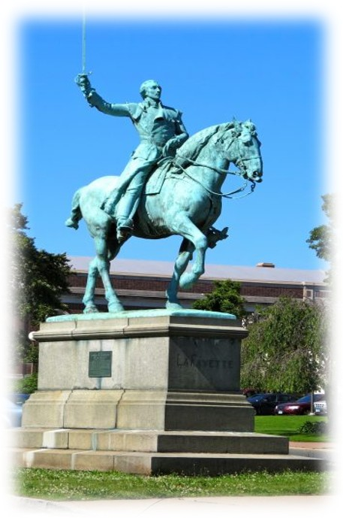
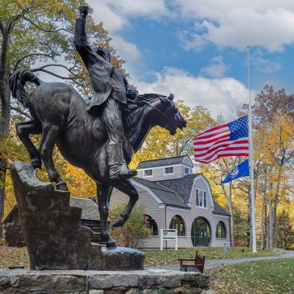
Horses Preserve our Heritage … Connecticut has a rich in history of how horses have been instrumental then and now.
A statute of Lafayette, a general in the American Revolutionary War is across from the state Capitol in Hartford, CT. Our capitol also depicts pictures of horses in battles and there are several monuments around our state that feature heroes mounted on horses.
A statute of General Israel Putnam's daring escape at Horseneck, (now part of Greenwich) from British dragoons, during the Revolutionary War. Putnam, surprised and outnumbered, famously rode his horse down a steep cliff, and the British, unable to follow, fired at him. Winter Camp 1778/1779.
Putnam Memorial State Park in Redding, Connecticut

Slide 11
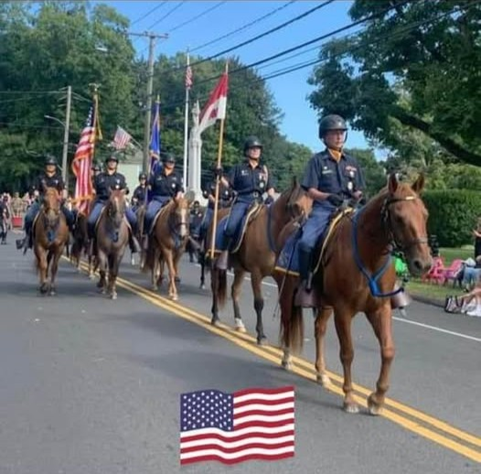
Horses Preserve our Heritage … Connecticut has a rich in history of how horses have been instrumental then and now.
Today we continue a tradition of 2 Connecticut Horse Guards and 2-foot Militia dating back to the 1700’s
Connecticut has four colonial militia units, two Foot Guards and two Horse Guards, all member units of the Connecticut National Guard.
The First Company Governors Horse Guard and the Second Company Governors Horse Guard are strategically stationed in Avon and Newtown, respectively.
Historic cavalry units, Connecticut carries on the volunteerism of the earliest American Colonials ensuring the safety of their Governor.
Today, all four units are seen throughout the state representing the governor at parades, reviews and ceremonies including presidential inaugurals.
The Connecticut Horse Guards are living history.

Slide 12
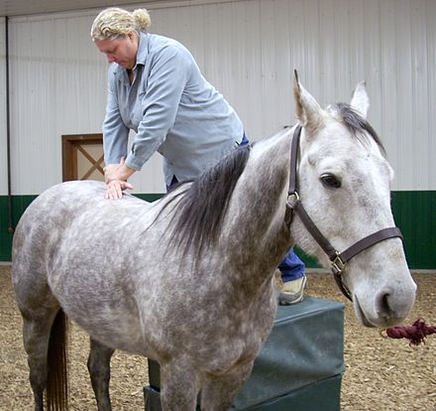
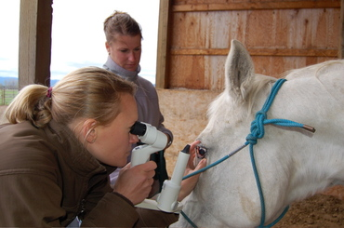
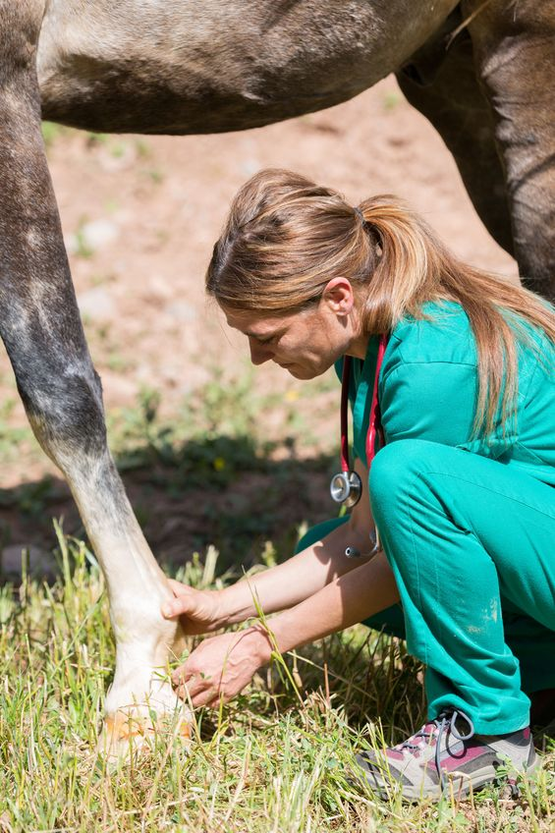
Horses Create Jobs.
Did you know that there are 9.2 million horses in the US, including both commercial and recreational horses? And did you
know that nearly 5 million Americans are involved with horses as owners, service providers, employees, and volunteers? Two million Americans own horses. The median income of horse owners in the United States is around $60,000, with horse ownership spread across a wide range of incomes.
The economic value horse owners bring into local economies is notable. The American Horse Council further reports that the horse industry pays a total of $1.9 billion in taxes to federal, state, and local governments and directly produces $39 billion worth of goods and services each year. The impact on the US economy is over $100 billion when you consider how much money industry suppliers and employees spend. That’s more that the motion picture and railroad transportation industries contribute to the US Gross Domestic Product. And it’s only slightly smaller than what the apparel and other textile products industries contribute.
The horse industry directly provides 460k full-time equivalent jobs across the US and supports a million more than that. Amazingly, the horse industry employes more people than railroads, radio and television broadcasting, petroleum and coal products manufacturing, and tobacco product manufacturing.

Slide 13
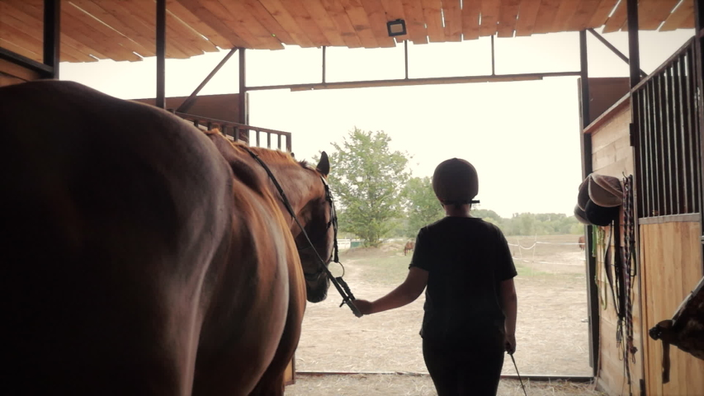
Interested in a job in the horse industry? There are many fulfilling and well-paying careers to pursue for people who love horses. The average annual salary for full-time farriers is over $100k; trainers can earn between $70k – 170k per year; and as of January 2025, equine veterinarians in CT will earn approximated $157k per year. Here are just some of the equine related jobs and careers to consider, and others that are supported by the horse industry:
Here are some jobs that exist
solely because of horses:
Farrier
Equine Veterinarian
Groom
Trainer
Handler
Farm & Barn Manager
Breeder
Equine Physical Therapist
Horse Facilities Manager
Mounted Police Officer
Saddle Maker and Fitter
Equine Product Vendor
And here are some other products
and services that horse owners
regularly support:
Trucks/heavy duty vehicles
Horse and Utility Trailers
Fuel
Farm Equipment and Supplies
First Aid Supplies
Pharmaceuticals
Feed and Hay
Restaurant and Hotels
Insurance
Medical and Legal Services

Slide 14
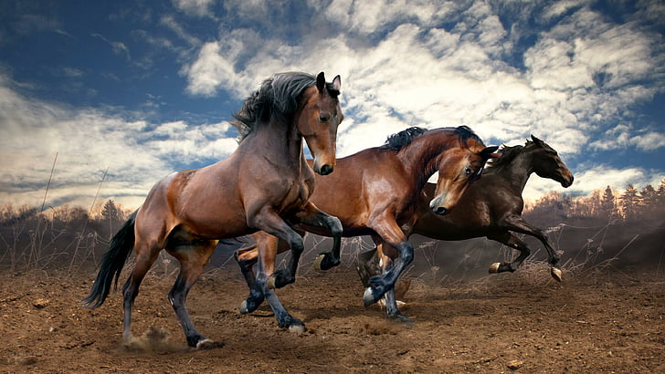
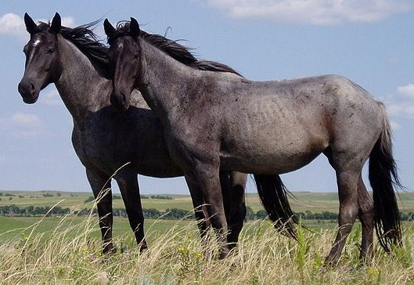
Horses Inspire Passion.
What could be better than a neighbor who is so consumed with something she’s passionate about that she doesn’t have time to look for shortcomings in her neighbors (including you!)? Think about how much you love your favorite past-times – maybe gardening, cooking, quilting, fixing cars, playing music, walking your dog – if you attend a function where horses are the focus, it will become apparent that people who love horses love them a LOT. There is something about horses that brings our passion in people, even those who don’t own horses.
Passion for horses if particularly strong in kids. Just do a Google search for horses and children and you will come up with over 28 million results. Small children love to see, pet, groom, ride, and draw horses. Ever notice how many kids’ drawings are of horses? Kids enjoy learning facts and reading stories about horses and seeing horses in person.

Slide 15
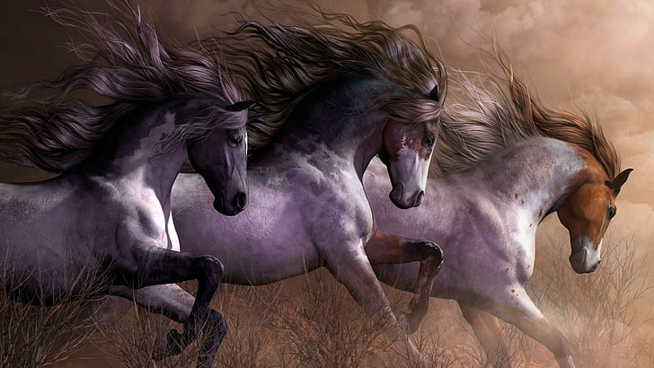
Horses Inspire Beautiful Art.
At some level, there is an artist in all of us. Some oare better than others at expressing their inspirations artistically, but most of us enjoy being around artwork, be they paintings, sculptures, photographs, sketches, etc. In fact, art is big business all over the world and horses have long been inspirations for art. Horses are so important in the art world that there are guilds, magazines, galleries, and more devoted solely to equine art.
Start taking note of the wall hangings and sculptures in various places within your community and changes are you’ll see horses. Where you’ll really notice them is in the magnificent statues and paintings in and around government buildings all across the nation. In these works, the horse is heralded as a magnificent animal that has carried man.
So, the next time you glimpse a horse through your kitchen or car window, consider that he may be the ideal subject for an up-and-coming Picasso that you know.

Slide 16
How To Keep Your Good Neighbors.
Here are some things you can do to ensure that horses continue to be part of your community:
Remember that good neighbors are never perfect.
Let’s be honest about some of the downsides of having equine neighbors. You may have concerns about flies and odors that you are not accustomed to. Occasionally, horses can get loose. It’s also not fun to get stuck behind a slow-moving horse trailer.
But the positives of having horses around far outweigh the negatives. Most of the negatives can be addressed by better
management practices on the part of the horse owners and caretakers. And some of the negatives associated with horses are mere myths.
Communicate with horse owners.
If you have a concern about an equine neighbor, please consider doing the neighborly thing and try to work your concerns out with the horse owner and/or farm manager.
Support equine-friendly zoning.
True or false – it takes a lot of land to keep a horse? Turns out, the answer is false. Extensive pastureland is not a requirement for keeping a healthy horse. What is required is proper diet, fresh water, a clean environment, regular exercise, bodily maintenance, and social comfort – the same as for you and me.

Slide 17
When it comes to proposed zoning changes, be wary of provisions that require certain numbers of acres per horse, as these
requirements can effectively oust horses from communities for no legitimate reason. It’s a shame to see this happen when
you consider the value that horses add to communities.
All too often, isolated conflicts between neighbors lead to zoning boards considering acreage requirements that would make it financially impossible for the average person to have a horse or two of their own. The enjoyment of horses should never become an exclusive privilege available only to those who have enough money to afford expensive acreage. Rather than ousting horses from communities, horse owners should be educated about Best Management Practices and expected to be good stewards of the horse land they have. State departments of agriculture are great places to learn about Best Management Practices for pasture and farm care. Also visit the Equestrian Land Conservation’s Library of Resources page at www.elcr.org.
Many times, people make assertions about negative environmental impacts of horses that are based on hearsay versus scientific study. If you have questions or concerns about horses and the environment, please consult peer-reviewed scientific data rather than accepting other’s statements as true just because they sound persuasive.
Support equine-friendly open spaces and trails.
This country was first traversed by man and horse via interconnecting trails and dirt roads. Though travel by horse is firmly a part of our heritage, it becomes increasingly difficult to carry on this tradition as travel ways become paved with materials that are hard on horses and congested with fast-moving motorized vehicle. Please help your community save its traditional connections by supporting equine-friendly open spaces, greenways, and trails.
*******
THANK YOU FOR TAKING THE TIME TO READ THIS.

